Slide 1
Pig
Pig is an open-source tool that is built on the Hadoop ecosystem for providing better processing of Big data. It is a high-level scripting language that is commonly known as Pig Latin scripts.
Features of Pig:
It allows the user to create custom user-defined functions.
It is extensible to use.
Supports a variety of data types such as char, long, float, schema, and functions.
Provides different operations on HDFS such as GROUP, FILTER, JOIN, SORT.

Slide 2
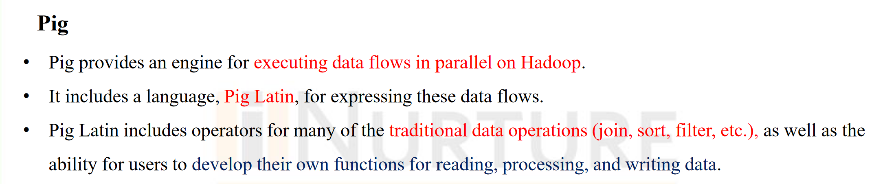
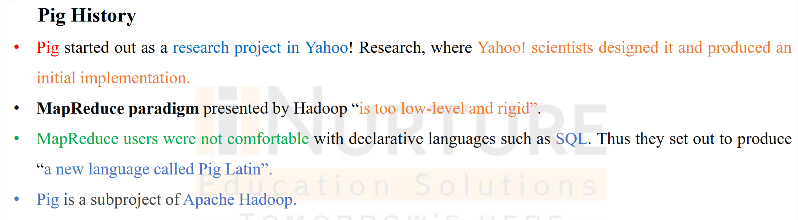

Slide 3
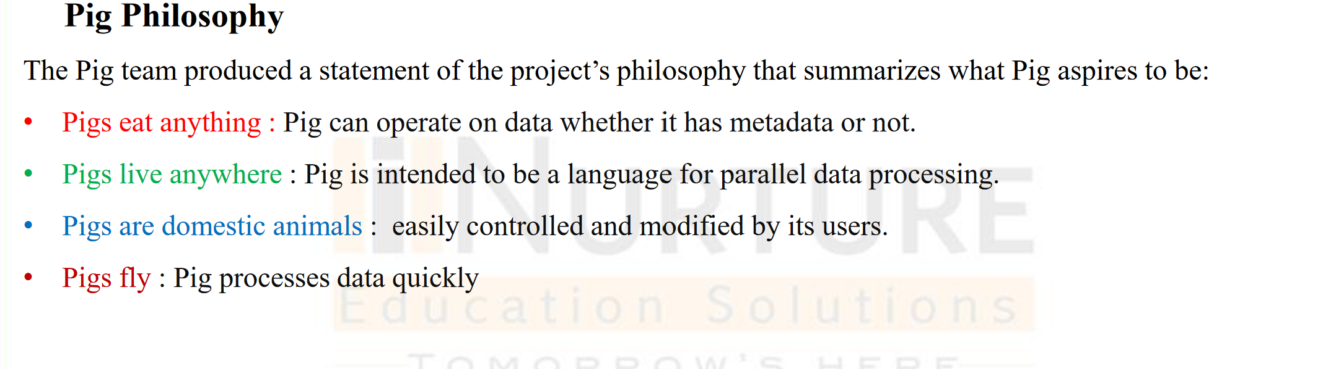

Slide 4
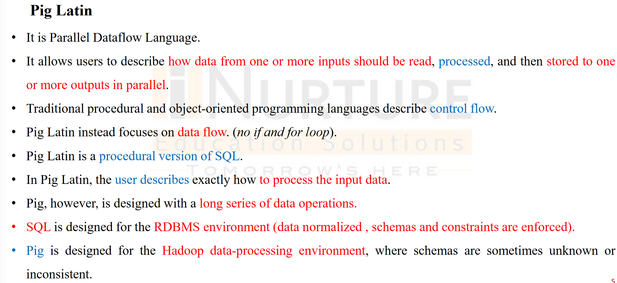

Slide 5
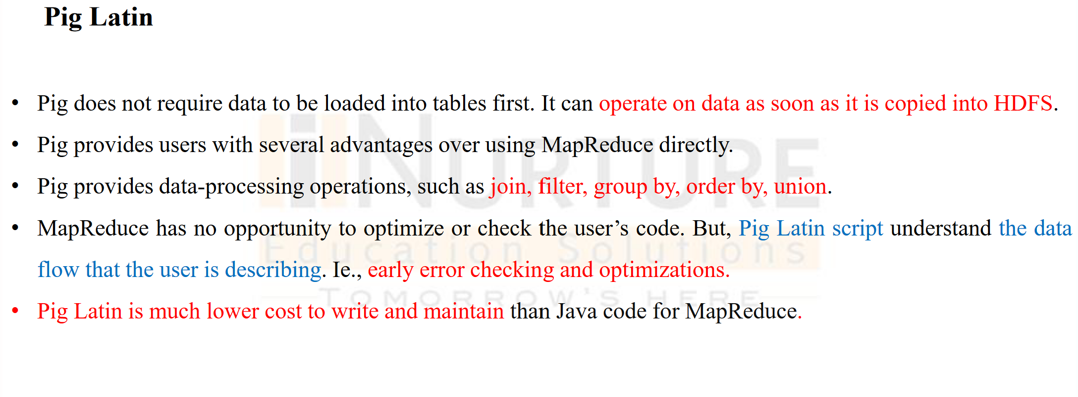

Slide 6
Apache Pig Execution Modes
You can run Apache Pig in two modes, namely, Local Mode and HDFS mode.
Local Mode
In this mode, all the files are installed and run from your local host and local file system. There is no need of Hadoop or HDFS. This mode is generally used for testing purpose.
MapReduce Mode
MapReduce mode is where we load or process the data that exists in the Hadoop File System (HDFS) using Apache Pig. In this mode, whenever we execute the Pig Latin statements to process the data, a MapReduce job is invoked in the back-end to perform a particular operation on the data that exists in the HDFS.

Slide 7
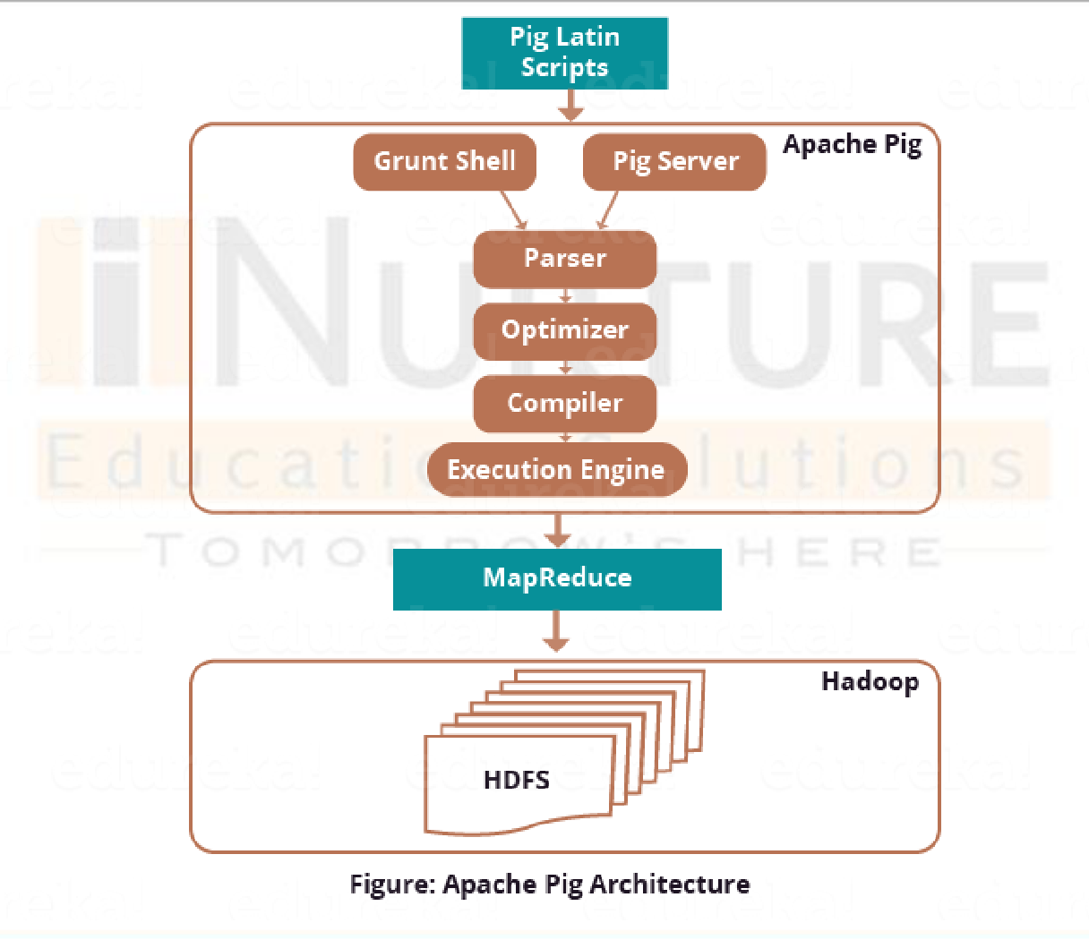
Architecture of Hadoop

Slide 8
Difference between MapReduce and Pig
S.No | MapReduce | Pig
1. | It is a Data Processing Language. | It is a Data Flow Language.
2. | It converts the job into map-reduce functions. | It converts the query into map-reduce functions.
3. | It is a Low-level Language. | It is a High-level Language
4. | It is difficult for the user to perform join operations. | Makes it easy for the user to perform Join operations.
5. | The user has to write 10 times more lines of code to perform a similar task than Pig. | The user has to write fewer lines of code because it supports the multi-query approach.
6. | It has several jobs therefore execution time is more. | It is less compilation time as the Pig operator converts it into MapReduce jobs.

Slide 9
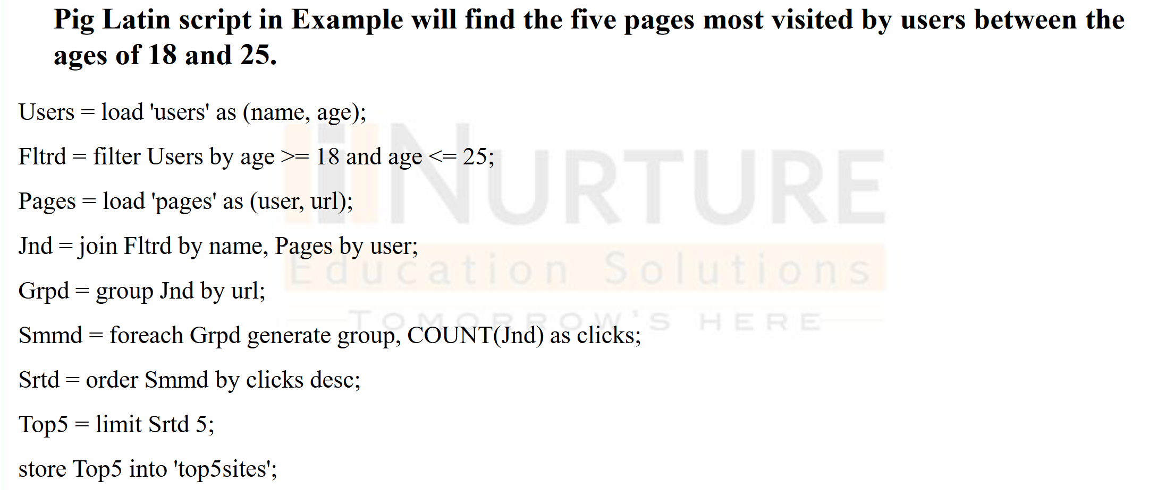

Slide 10
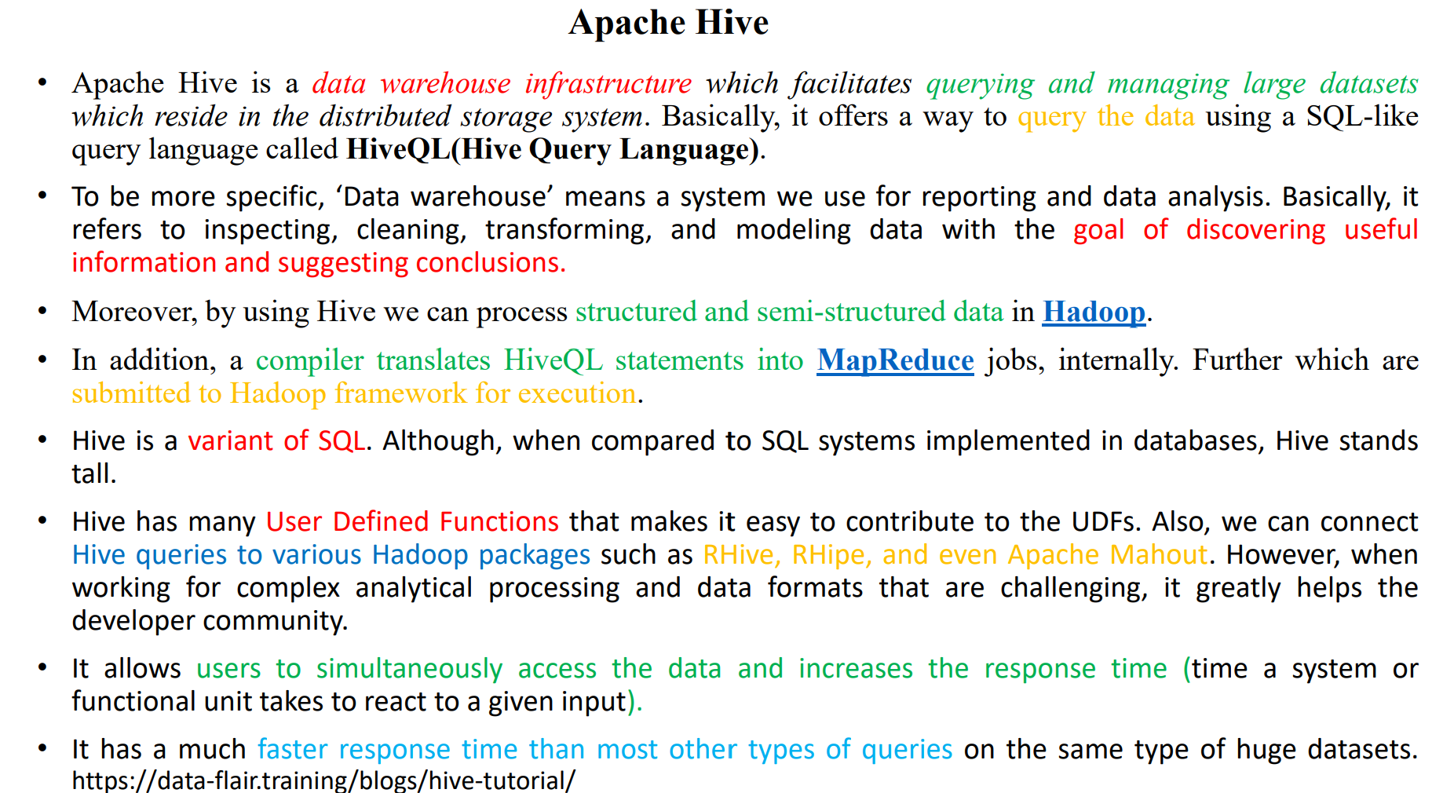

Slide 11
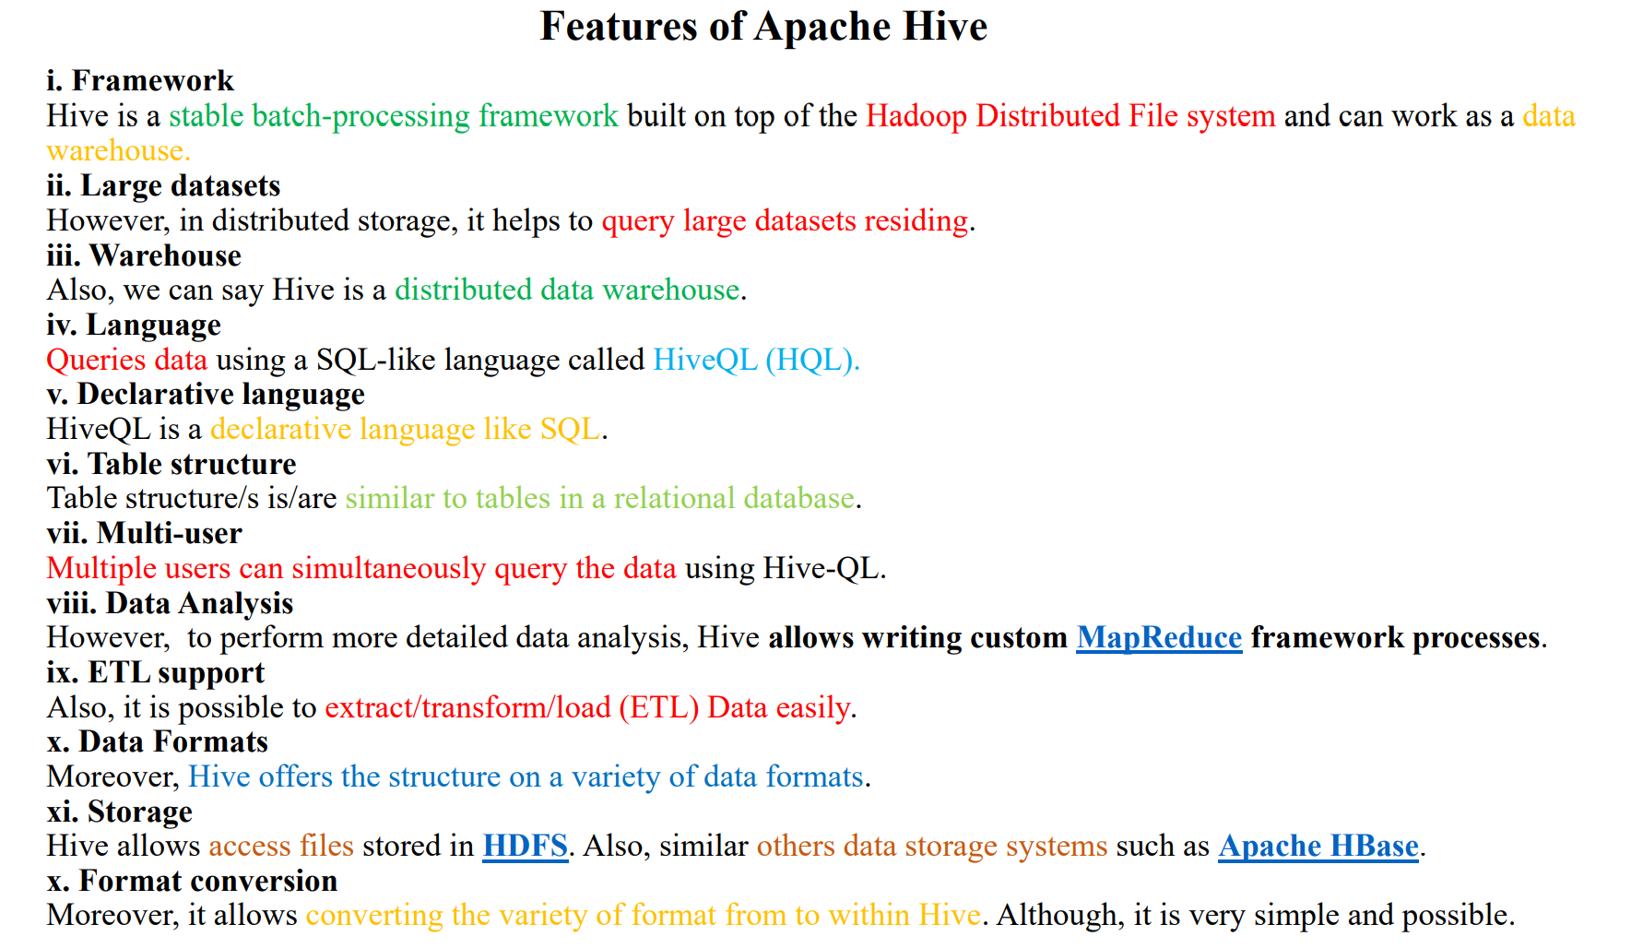

Slide 12
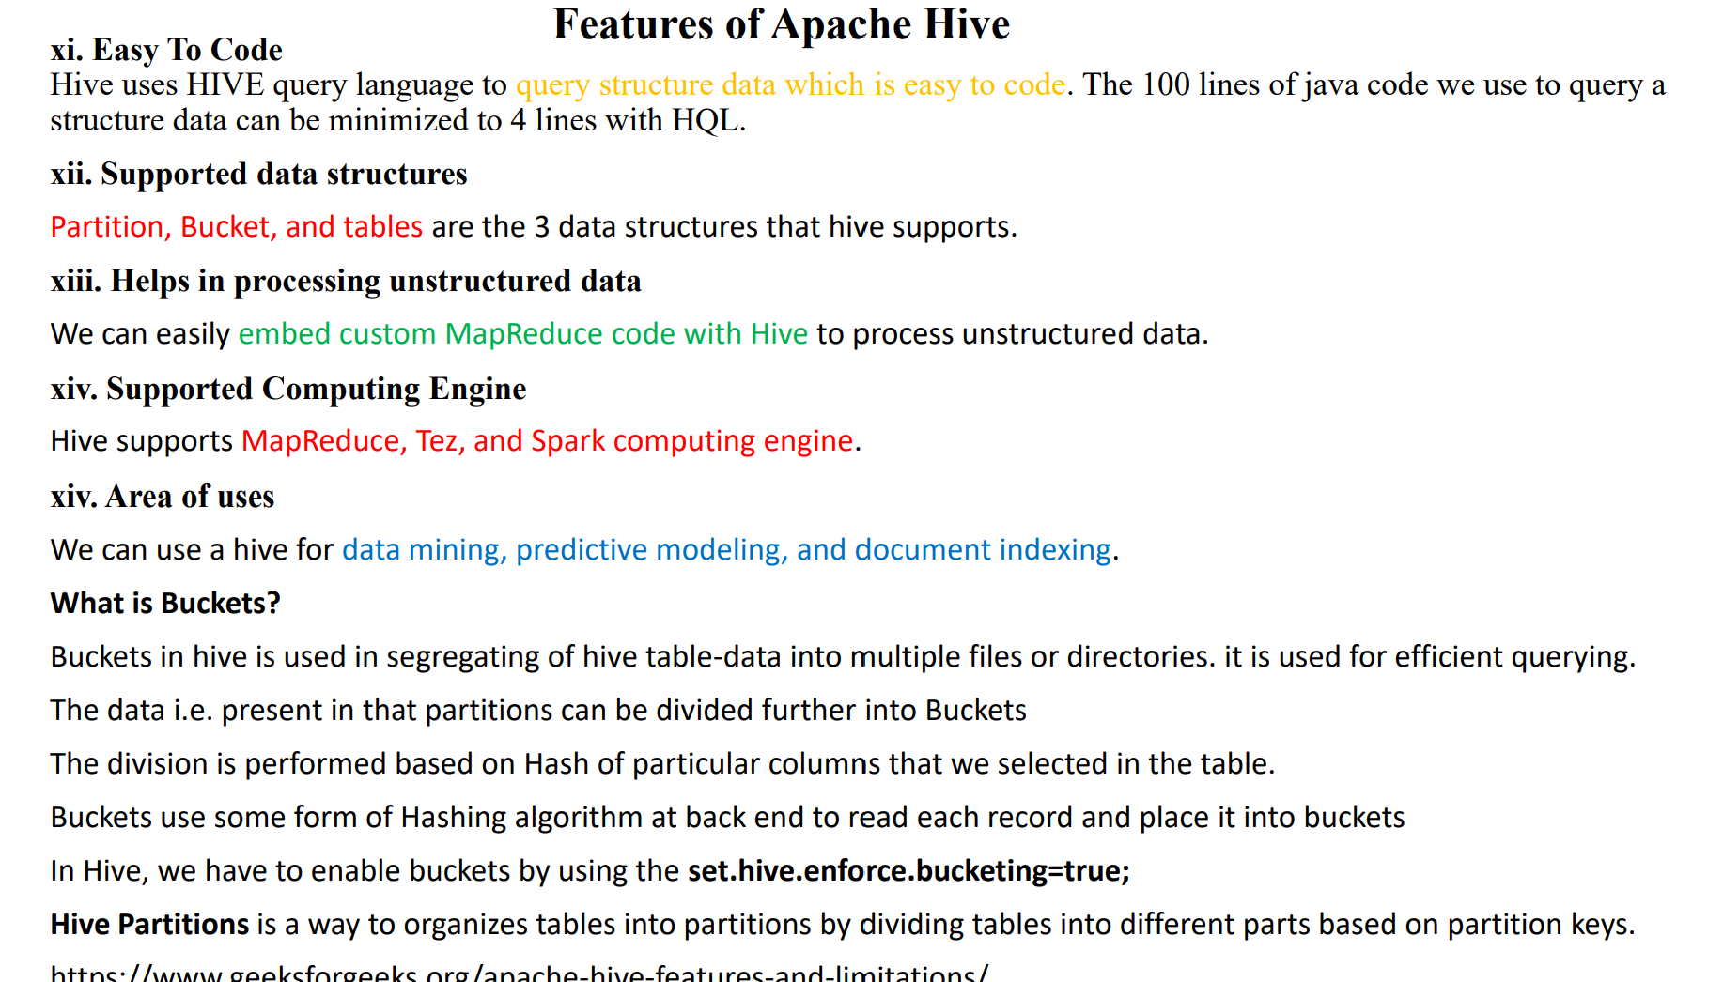

Slide 13
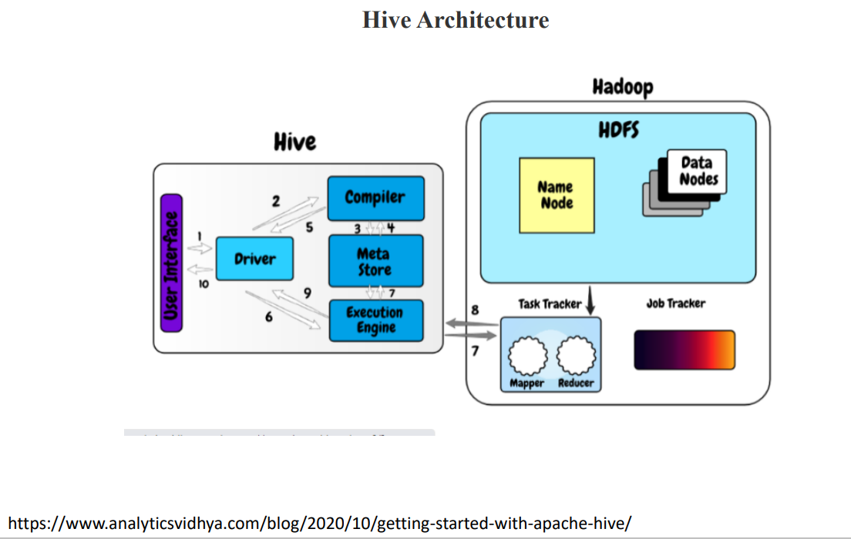

Slide 14
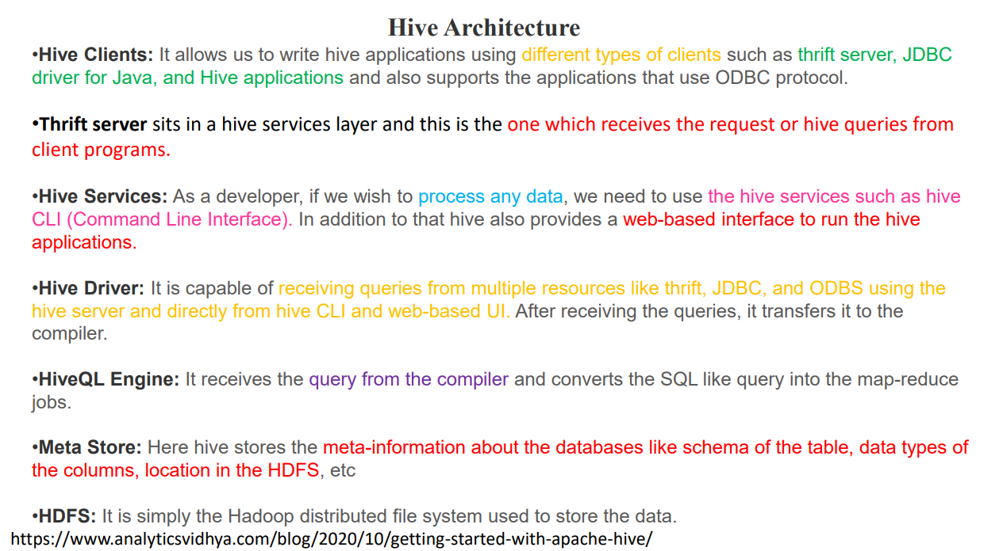

Slide 15
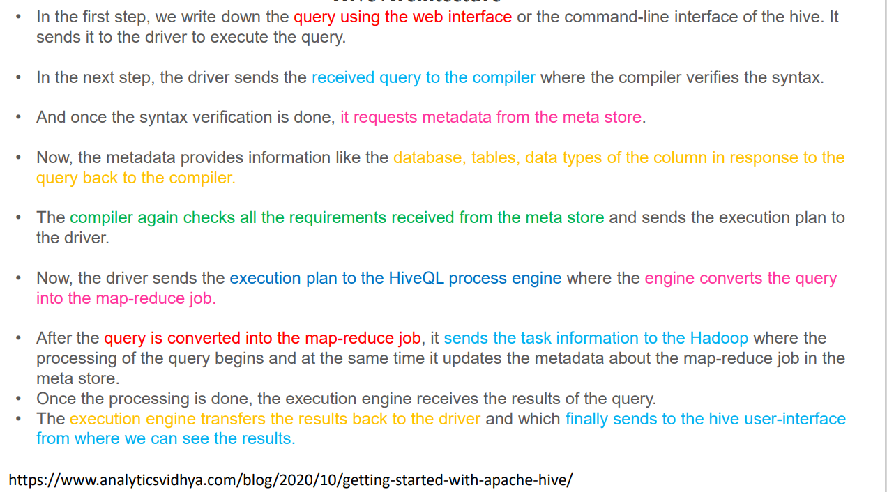
Hive Architecture

Slide 16
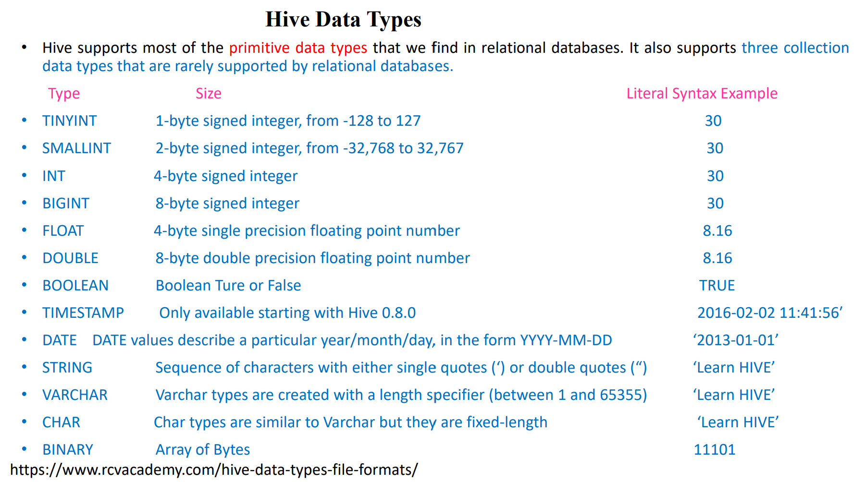

Slide 17
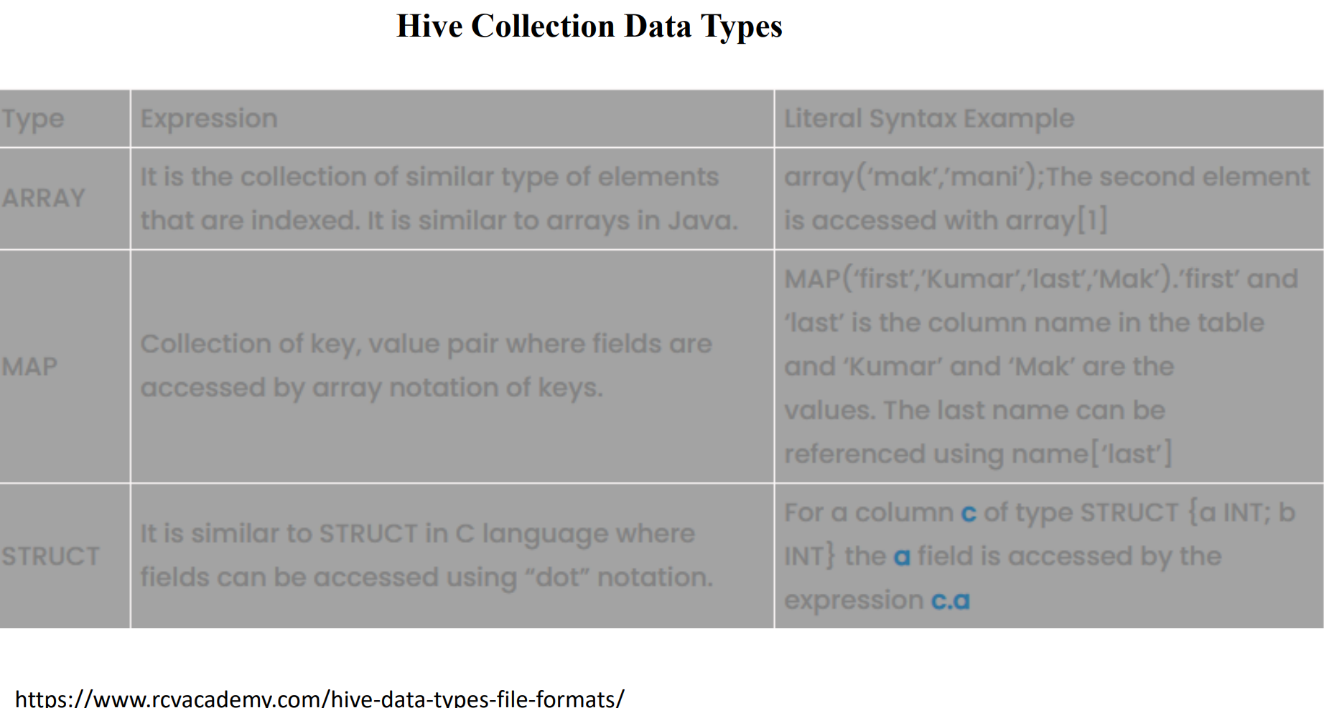

Slide 18
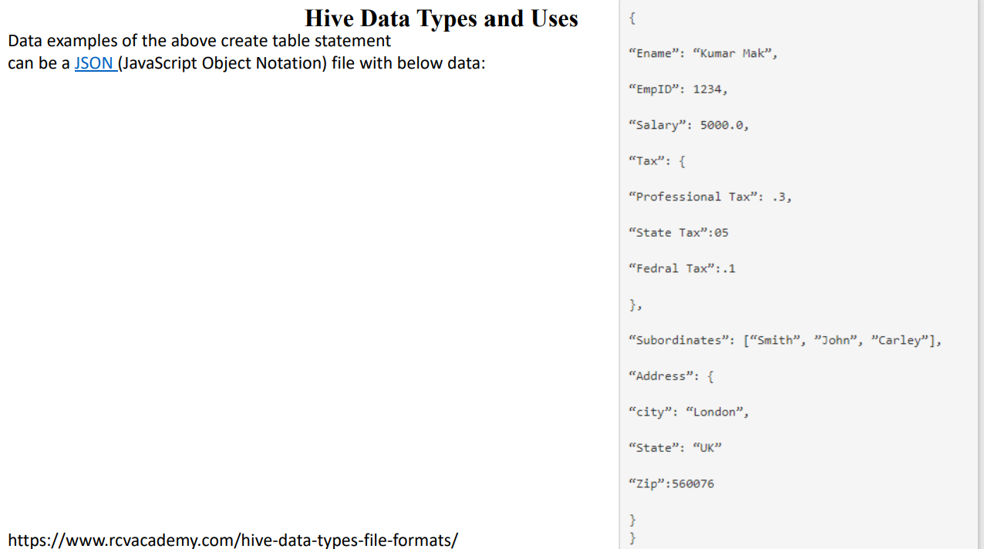

Slide 19
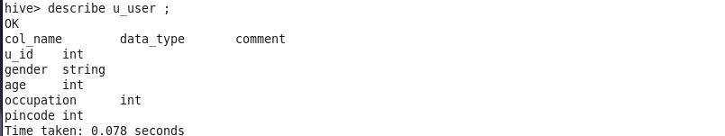
STEP 1: Create a u_user table.
STEP 2: SEE THE FIELD DESCRIPTIONS OF U_USER TABLE.

Slide 20
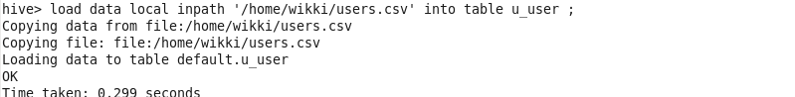
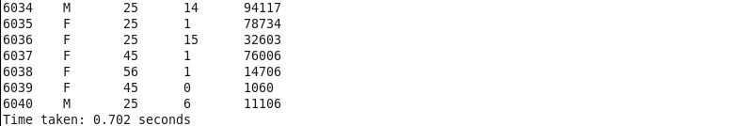
STEP 3: LOAD DATA INTO U_USER TABLE FROM A LOCAL TEXT FILE.
STEP 4: Show all the data in the newly created user table.

Slide 21
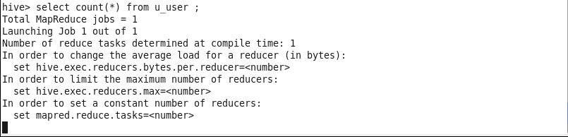
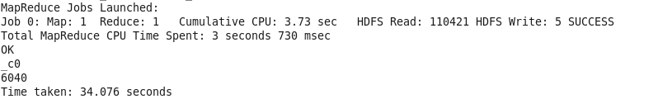
STEP 5: COUNT THE NUMBER OF DATA IN THE U_USER TABLE.

